Slide 1
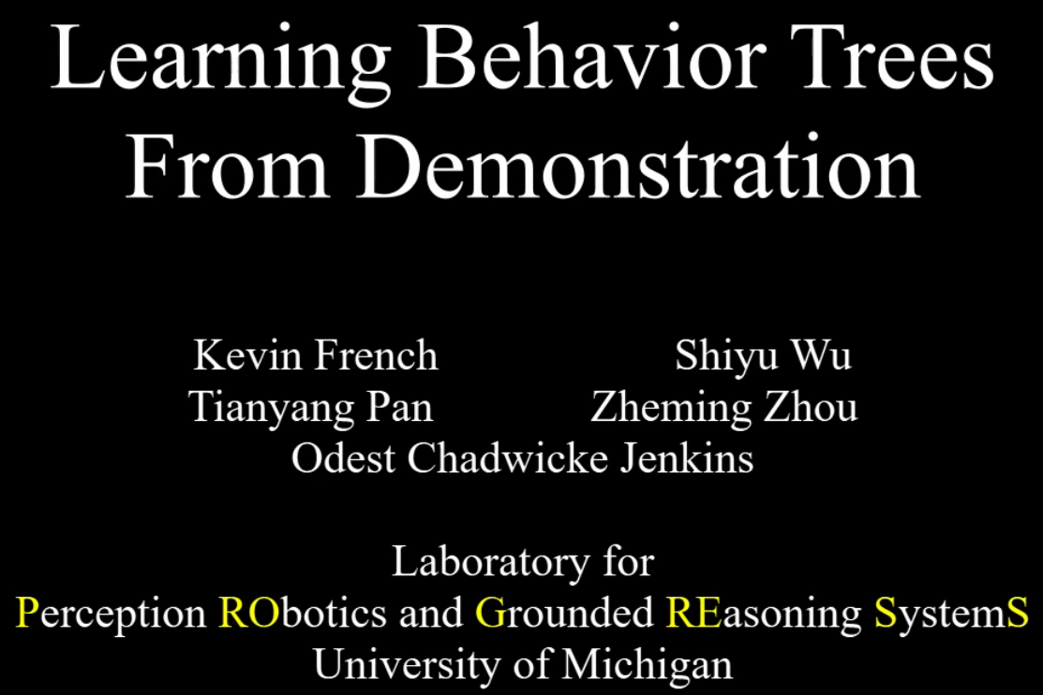
Notes:
感知机器人和

Slide 2
Motivation:
Anyone can program a robot for an arbitrary task
Learn Complex multistep task with many primitive actions from demonstration
Control structure

Slide 3
Choose BT:
Control structure : finite state machines, decision trees, formal logic -> BT
real time execution: highly responsive
Modularity: reuse
Transparency: interactive learning

Slide 4
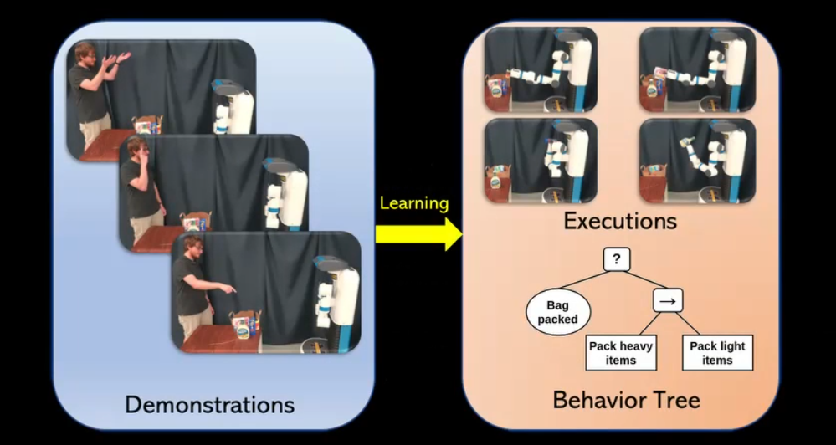
Example:

Slide 5
(High Level) Learning from Demonstration(LfD):
LfD studies how a robot could learn from a natural human demonstration.
Instead of using code, the user will just show the robot how to do what the user wants.

Slide 6
Three Steps of High Level LfD:
segment the primitive actions for learning
finding repeated substructure in demonstrations
sparse online Gaussian processes[4]
beta process auto-regressive hidden Markov model (BP-ARHMM)[2]
learn primitive actions
low level LfD
★learn the transitions between the primitive actions
generalization of observation of the world before and after actions are taken
finite state machine[4][2]
information theoretic[3]
grounded symbols of a formal logic [5]
learning the constraints on the motion instead of generalizing a trajectory [7]
Reference:
[2] S. Niekum, S. Osentoski, G. Konidaris, S. Chitta, B. Marthi, and A. G. Barto, “Learning grounded finite-state representations fromunstructured demonstrations,” International Journal of Robotics Research, vol. 34, no. 2, pp. 131–157, 2015
[3] C. Crick, S. Osentoski, G. Jay, and O. C. Jenkins, “Human and robot perception in large-scale learning from demonstration,” in Proceedings of the 6th international conference on Human-robot interaction. ACM, 2011, pp. 339–346.
[4] D. H. Grollman and O. C. Jenkins, Can We Learn Finite State Machine Robot Controllers from Interactive Demonstration? Berlin, Heidelberg: Springer Berlin Heidelberg, 2010, pp. 407–430. [Online]. Available: https://doi.org/10.1007/978-3-642-05181-4 17
[5] G. Konidaris, L. P. Kaelbling, and T. Lozano-Perez, “From skills to symbols: Learning symbolic representations for abstract high-level planning,” Journal of Artificial Intelligence Research, vol. 61, pp. 215289, 2018
[7]S. Chernova and M. Veloso, “Confidence-based policy learning from demonstration using Gaussian mixture models,” Proceedings of the 6th international joint conference on Autonomous agents and multiagent systems - AAMAS ’07, vol. 5, p. 1, 2007.
Notes:
稀疏在线高斯过程
beta过程自动回归隐藏马尔可夫模型
Using crowd sourced demonstrations a decision tree is learned maximizing information gain at every node of the decision tree. The decision tree is used to directly map the observation of the world to a primitive action.
使用群体源演示学习决策树，使决策树的每个节点的信息增益最大化。决策树被用来直接将对世界的观察映射到一个原始动作。

Slide 7
Contributions:
Last Step -- learn the transitions between the primitive actions:
Classification and Regression Tree algorithm (CART) [10] is used to produce a decision tree from the demonstrations
BT-Espresso (algorithm 2) to convert the decision tree into a behavior tree.
Reference:
[10] L. Breiman, J. Friedman, C. Stone, and R. Olshen, Classification and Regression Trees, ser. The Wadsworth and Brooks-Cole statistics-probability series. Taylor & Francis, 1984. [Online]. Available: https://books.google.com/books?id=JwQx-WOmSyQC

Slide 8
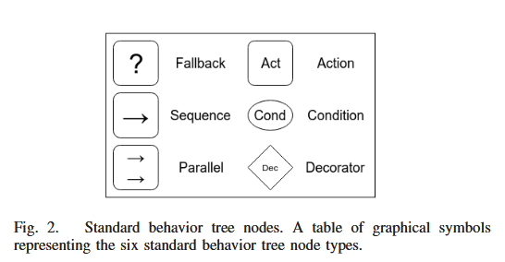
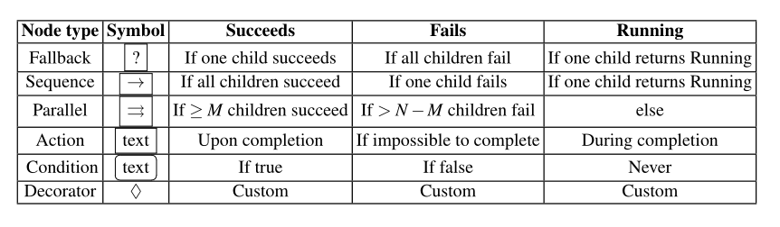
BT:

Slide 9
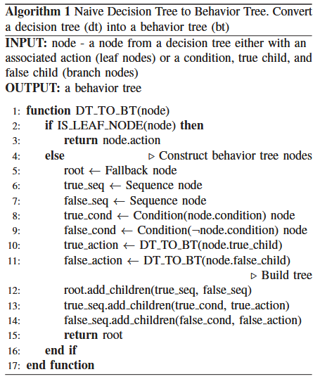
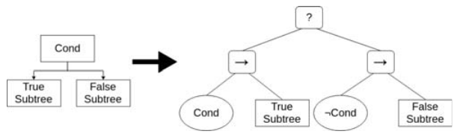
Approach:
not taking advantage of properties of decision trees to improve the behavior tree

Slide 10
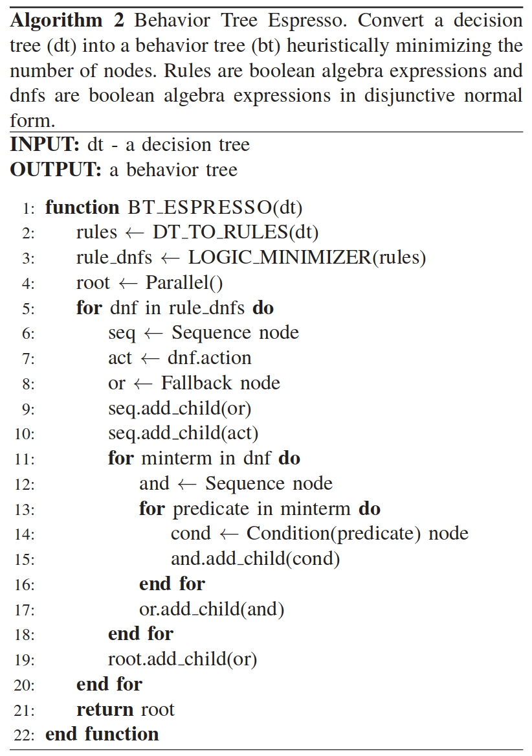
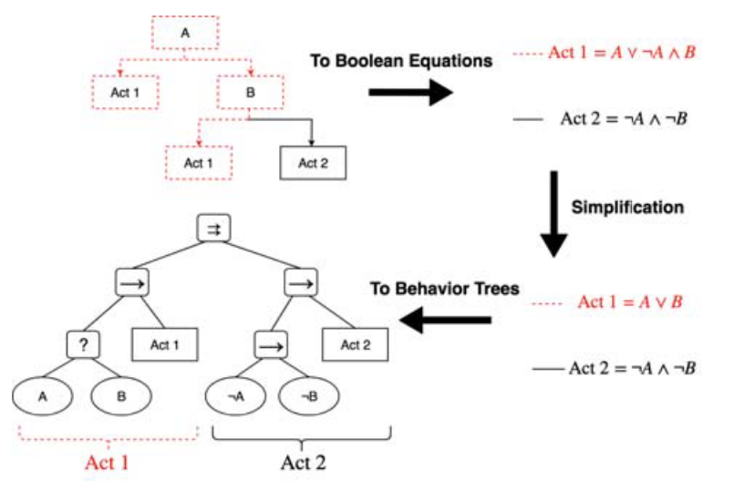
Approach:
First, it is shown that the output of algorithm 1 can be rearranged to allow for parallel execution.
Second, logic minimization is used to generate a behavior tree that requires less computation per execution cycle
QuineMcCluskey algorithm ×
UC Berkley’s Espresso √
Notes:
布尔代数表达式

Slide 11
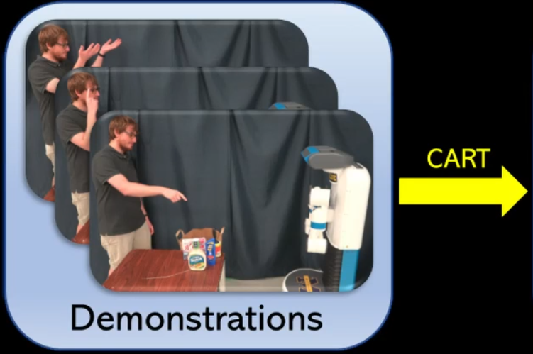
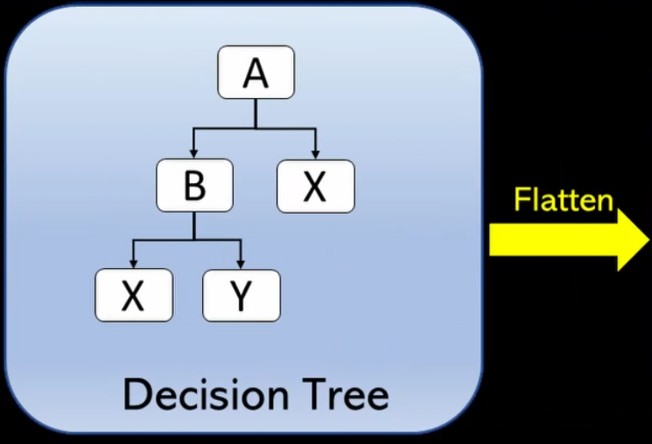
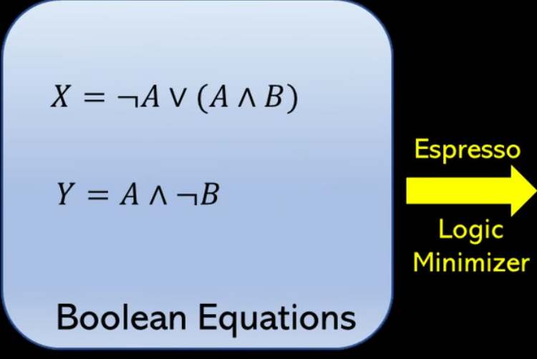
System Overview:
Notes:
分类和回归算法

Slide 12
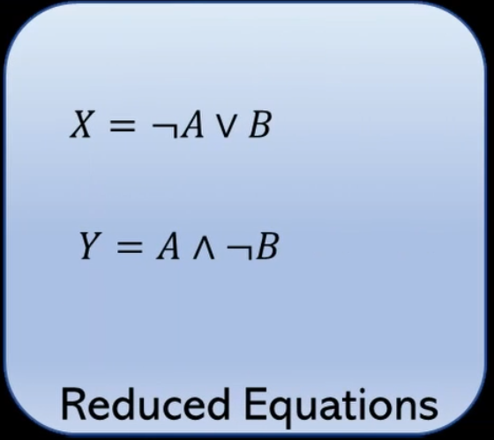
System Overview:
Notes:
分类和回归算法

Slide 13
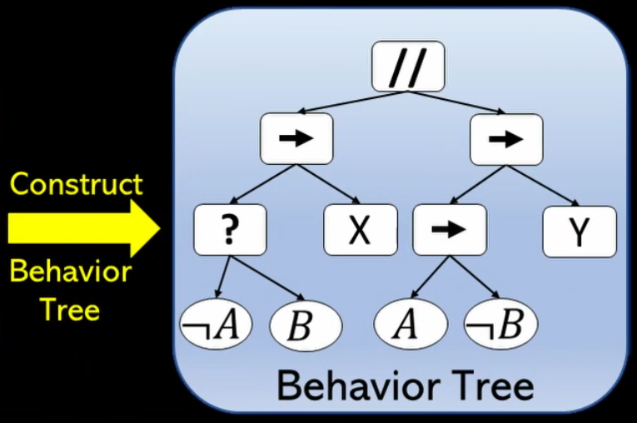
System Overview:
Notes:
分类和回归算法

Slide 14
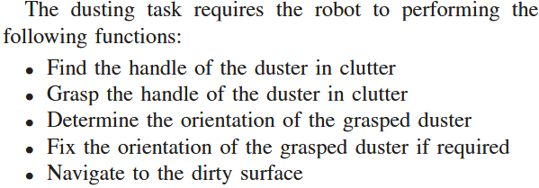
Experiment:

Slide 15
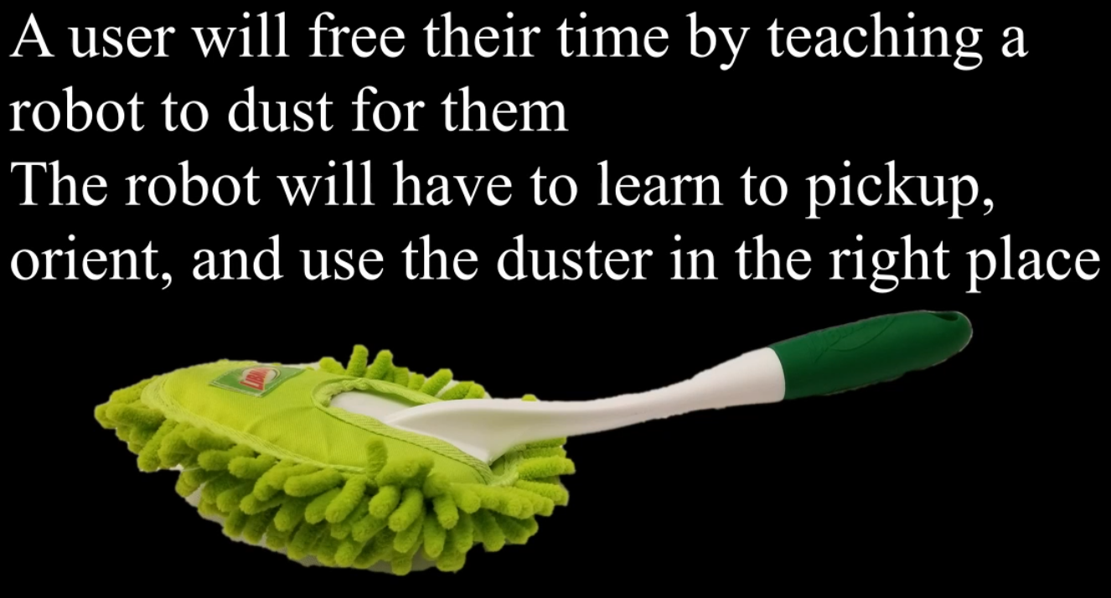
Experiment:

Slide 16
Results:
learned in 40 minutes ( 5 demonstrations a minute )
CART + algorithm 2 ( less than a second )
Quine-McCluskey algorithm ( 7 minutes )

Slide 17
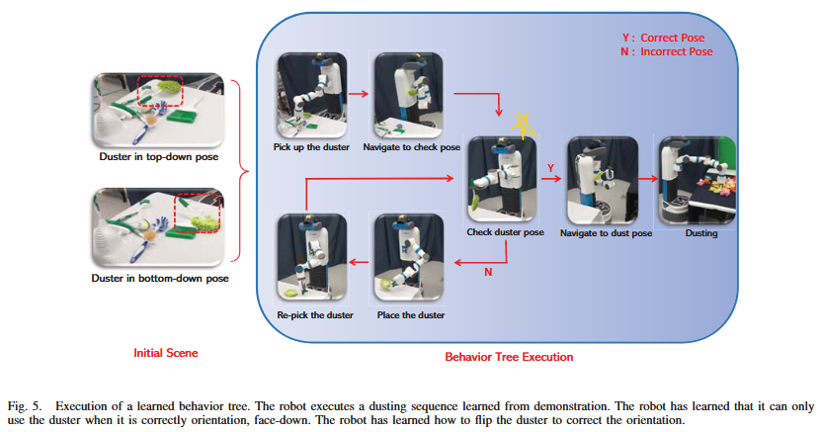
Execution:

Slide 18
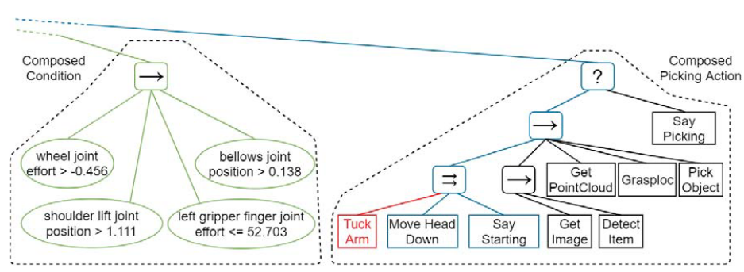
Learned BT:

Slide 19
